Slide 1
The future of housing supply: How can councils help build ONE MILLLION HOMES
Cllr Keith House Co-author “Local Government Role in Housing Supply” (2015) Leader, Eastleigh BC
27 September 2016
www.local.gov.uk

Slide 2
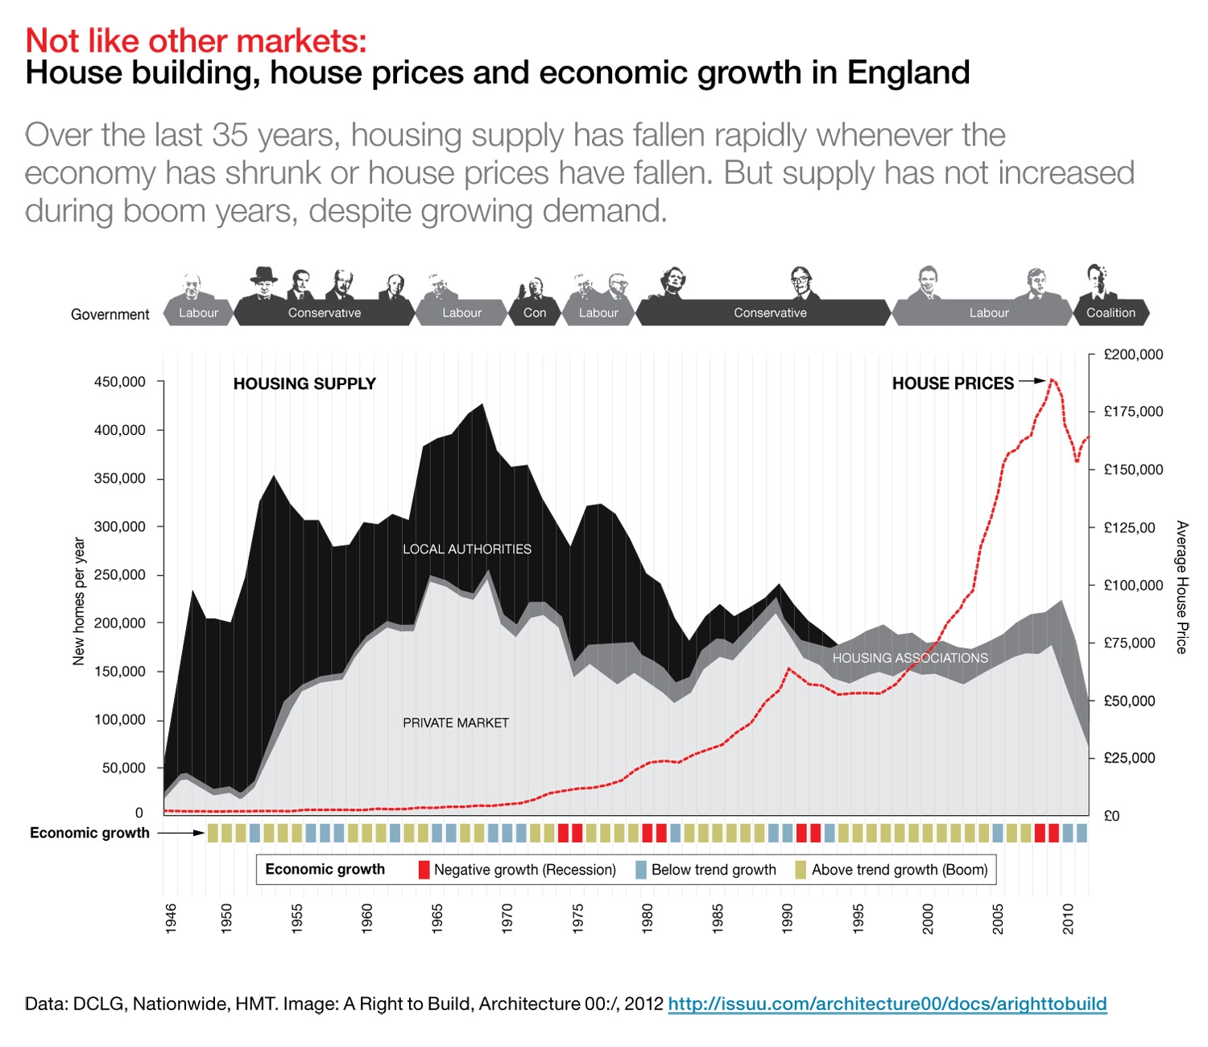
Context
Under supply of housing for nearly 40 years
Accepted need between 200-300,000 allowing for catch up
Current supply typically 150,000 (last quarter ‘16 showed 190,000 inc 30,000 conversions)
Government target of “One million homes”
Fundamental – more homes = more affordable

Slide 3
Local government’s wider role in housing
Planner and place-shaper
Developer
Landlord
Housing duties to the vulnerable
Housing duties to enable an effective private rented sector
But: we’re not building enough homes. Why?

Slide 4
But we’re not building enough homes…
Isn’t is all about planning?
It’s what government has often said
Isn’t it all about lack of useable cash?
It’s what councils have often said

Slide 5
What are we going to do?
Big changes from Government - Housing & Planning Act Autumn Statement 2015 Budget 2016 Autumn Statement 2016 Housing White Paper – all will help, won’t it?
Local authorities resource constrained – or are they?

Slide 6
Chancellor Osborne
£20bn for housing before AS 2016 - possibly biggest ever boost for housing
Funding for Starter Homes
Funding for Help to Buy
Loan funding for developers
Emphasis on more home ownership

Slide 7
Housing & Planning Act
Aimed at clear shift to home ownership
Extension of Right to Buy to Housing Associations
Pay to Stay
Starter Homes
Compulsory Purchase Orders
Rogue Landlords

Slide 8
Chancellor Hammond Autumn Statement 2016 – A reality check
£2.3bn Housing Infrastructure Fund to unlock supply – 100,000 homes?
£1.4bn for 40,000 extra affordable housing starts for affordable rent and low cost ownership
£2bn for accelerated construction on surplus public sector land
Pay to Stay becomes voluntary

Slide 9
The Housing White Paper
“The right homes in the right places”
We need to build homes faster
We will diversify the housing market
We will help people now

Slide 10
The Housing White Paper
Speed up Local Plans
Objectively assessed housing numbers
Ensure every Council has a plan, updated every 5 years
Option of combined plans
Homes in the Right Place
No greenbelt reduction
Renewed focus on brownfield
Increase density
Public land (again)

Slide 11
The Housing White Paper
Build Homes Faster
Increase Fees
Charge for Appeals
2 Year Permissions
Infrastructure and Skills
£2.3bn Housing Infrastructure Fund
Review S106 and CIL
“Housing Delivery Test” for councils

Slide 12
The Housing White Paper
Councils and Housing Associations
Potential post 2020 to borrow against income
New vehicles and JVs?
Homes England (HCA) to help
Diversify the Market
£3bn Home Building Fund
Review S106 and CIL
Modern methods of construction
Councils to plan for more homes for older and disabled people

Slide 13
The Housing White Paper
Lots of good stuff…

Slide 14
After the Election: New Consensus?
Progress since publication -
Sajid Javid announces prospectus for Housing Infrastructure Fund at LGA Conference
And states that consultation on new “Objectively Assessed Need” simplification will follow later in July
Grenfell Tower Disaster
Renewed emphasis on regulation
Questions on standards and building control
Retrospective refits?
New emphasis on affordable housing?

Slide 15
Will it build more houses?
…a qualified “yes”

Slide 16
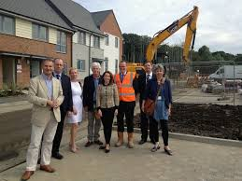
…it won’t happen by itself…

Slide 17
Leadership!

Slide 18
Planning Matters
Local Plan
5-Year Supply
Being innovative

Slide 19
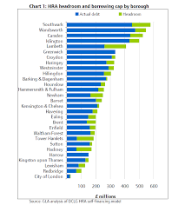
Finance Matters
The Council’s business plan
Borrowing powers
Understand why development is blocked
Sort it out

Slide 21
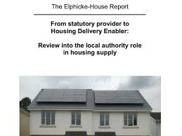
Leadership Matters
Political and managerial leadership
Own the problem
Identify solutions
Deliver them

Slide 22
What can councils do?
Maximise use of HRA borrowing
Understand stalled sites - and deliver
Re-examine underused land
Setting up a housing company
Directly invest for market sale and rent
Forward-fund infrastructure
Buy and develop land

Slide 23
Why directly invest?
1/3 – 1/3 – 1/3 – Sale / Market Rent / Affordable
Market rent
Improve quality of sector
Tenure diversity
Insatiable forward demand
Income to council
Increase supply as avoids absorption issues
Market sale
Direct commissioning as part of business case
Cash-flow assistance for viability
Market sale

Slide 25
Local government improvement
Councils committed to sector-led improvement
Financial circumstances forcing new innovations and partnerships
LGA has sector-led innovation hub, keen to capture and share practice
Housing & Finance Institute set up following Elphicke-House Report & Budget 2015

Slide 26
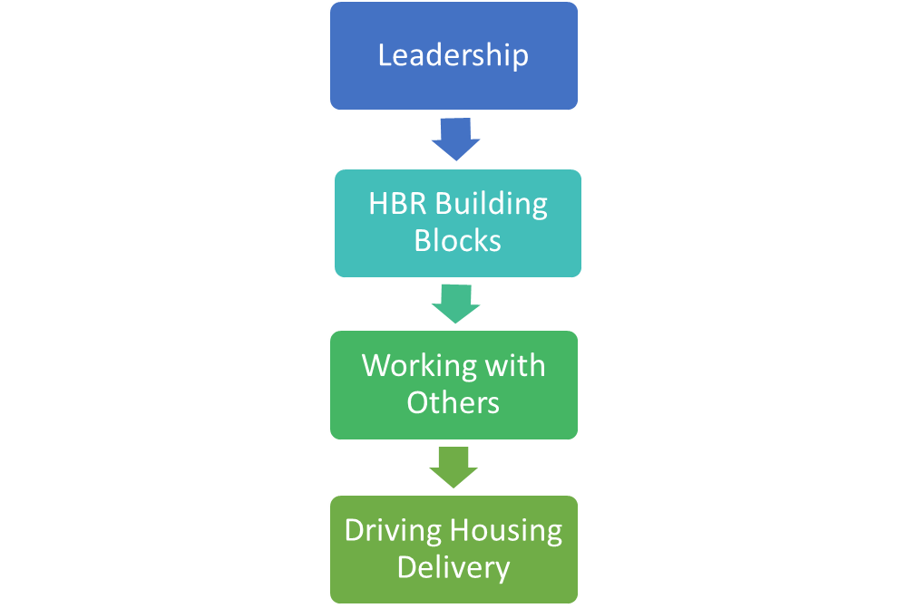
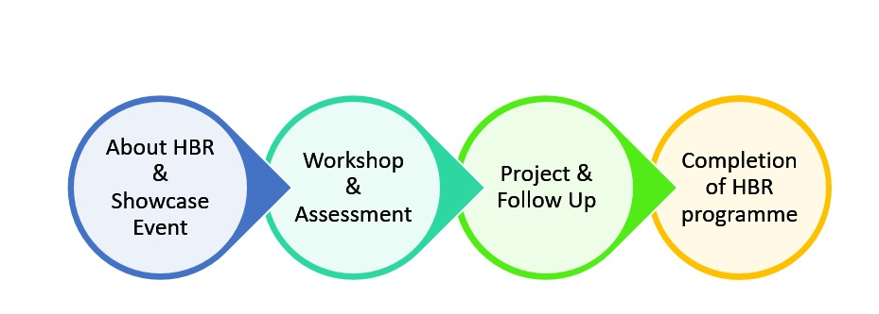
The Housing & Finance Institute
The HFi works nationally with business and councils to support capacity building for homes
Flagship Housing Business Ready programme for councils
Worked with around 50 councils (district, borough, unitary, county) and LEPs
Launching new Growth Programme for county councils in 2017
Running first national Infrastructure dependencies pilot – housing & growth capacity
4 sections of HBR
4 parts to the programme

Slide 27
There is no silver bullet
Improvement relies on:
Powers
Flexibilities
Certainty
Partnership
Leadership

Slide 28
www.thehfi.com Keith.House@eastleigh.gov.uk
27 September 2016
www.local.gov.uk

